Slide 1
City of Fort Wayne
Post Construction
BMP Program
City Utilities
Fort Wayne, Indiana
GENERAL PUBLIC TRAINING

Slide 2
Public meeting notice

Slide 3
Post Construction BMP Program Agenda
Your inspection matters
Why do we care?
What is a BMP?
Standardizing BMP Systems and Types
Why do we need to inspect?
Catching Rain BMP application

Slide 4
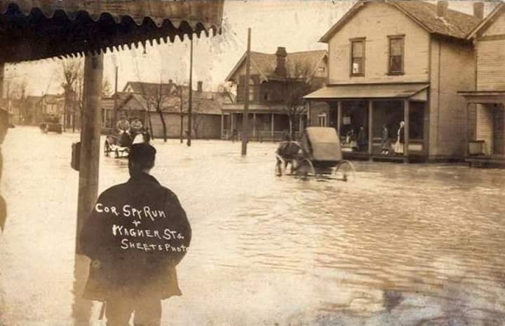
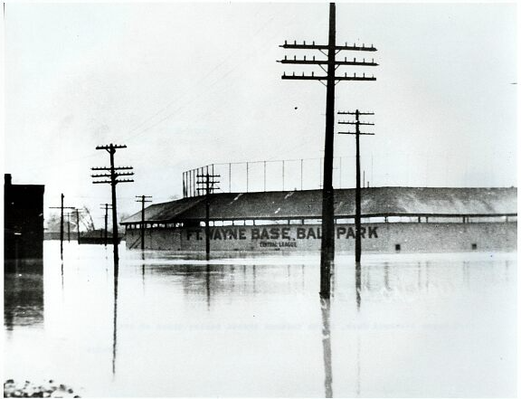
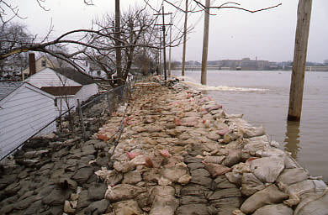
Storm Water Quantity and Quality
Great Memories and History of Fort Wayne.(c.a. 2018). In Facebook [Group Page] retrieved 07, 03, 2023 from https://www.facebook.com/groups/195279511153069/
Flood of 1913:
News-Sentinel.(c.2013). /anscontent.news-sentinel.com/?q=gallery/2013/news-sentinel-flood-1913-photos
Flood of 1913:
Pemberton Dr. photo courtesy Fire Fighter Album, ACPL
Pemberton Drive 1982

Slide 5
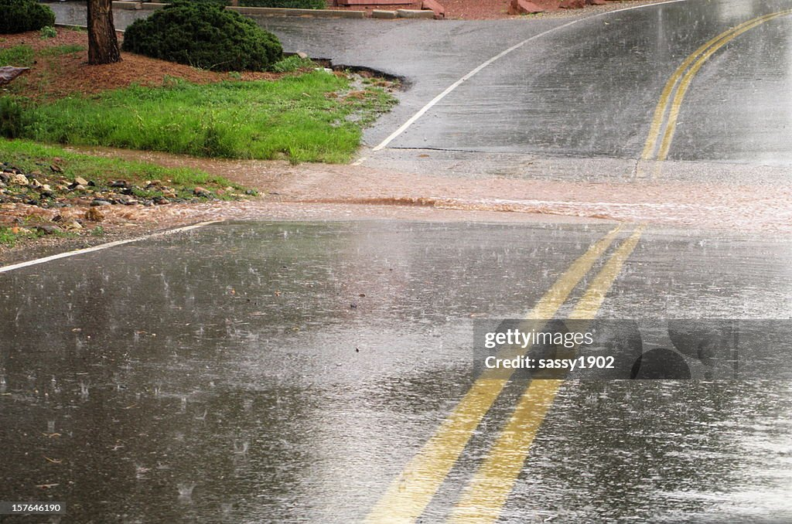
Storm Water Quality
When stormwater runs off impervious surfaces, such as pavement or roofs, it picks up pollutants like fertilizer, sediment, oil, and bacteria
This polluted runoff then enters the sewer system, and can end up flowing into our rivers
This polluted stormwater runoff is one of the biggest threats to clean water and clear rivers
flows-goes.jpg (1500×970) (mt.gov)

Slide 6
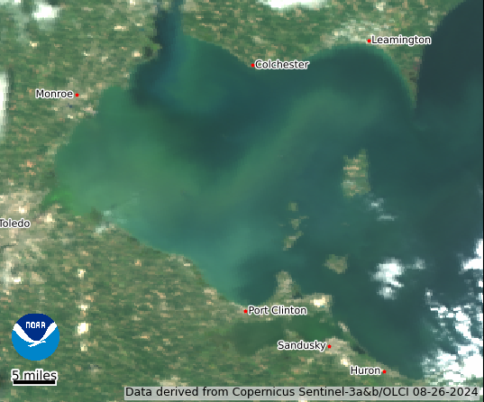
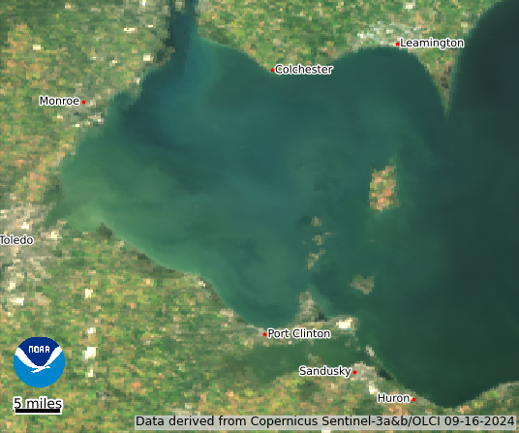
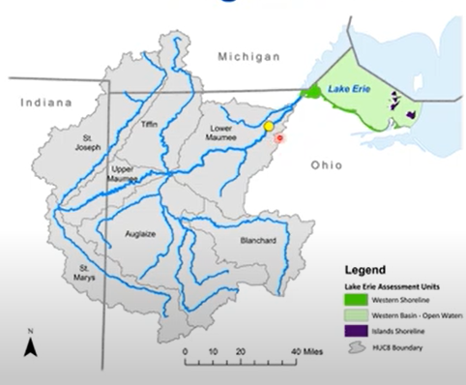
“Recent” Regional Water Quality Interest
Maumee River Watershed to Lake Erie
From epa.ohio.gov/divisions-and-offices/surface-water/reports-data/maumee-river-watershed

Slide 7
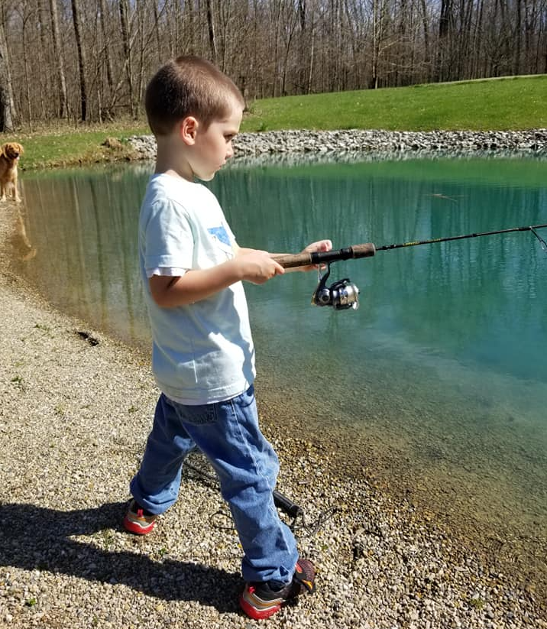
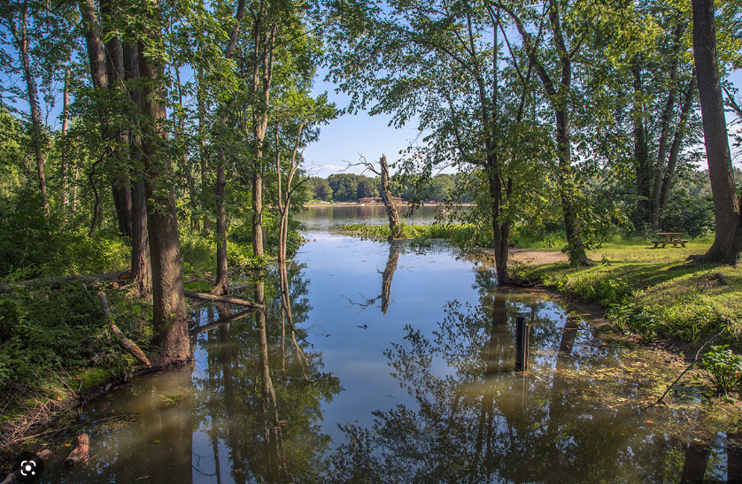
Why do we care?
What happened?
How are we adjusting?
How can we protect?
www.theguardian.com/global-development-professionals-network/2017/jun/02/china-water-dangerous-pollution-greenpeace
www.visitindiana.com/blog/post/picture-perfect-day-chain-o-lakes-state-park/
Chain O’ Lakes State Park

Slide 8
Local stormwater implementation plans over the years
Municipal Separate Storm Sewer System (MS4)
Conveyance system or systems owned by a state, city, town, village, or other public entity.
Discharges into waters of the U.S.
City of Fort Wayne is an MS4
Indiana Department of Enviromental Management (IDEM) implemented Clean Water Act – 1985
City established Stormwater Utility – 1991
National Pollution Discharge Elimination System (NPDES) Phase 2 implementation – 2004

Slide 9
How can we protect our water?
Utilize Best Management Practices (BMPs)
Definition: Structural and non-structural practices designed to treat stormwater to reduce flooding, erosion, and pollution problems caused by the loss of natural landscape and the increase of roads and buildings and other impervious surfaces that result from land development.
Goal: Treat stormwater to reduce flooding, erosion, and pollution problems.

Slide 10
Why should you care about BMPs?
Your money is invested in your BMPs when you built (or bought) your BMP (or facility)
Organizations are legally responsible for the ongoing operation and maintenance of their BMPs
They can prevent flooding and erosion of properties
BMPs prevent the pollution of our rivers and water supply

Slide 11
Your Post Construction BMPs What are they?
The goal of Post Construction BMPs is to prevent pollutant discharge by focusing on:
Quantity of run-off (flooding / sediment)
Quality of run-off (sediment / fuel / nutrients / other)
Post Construction Measures
After Construction, Long Term Facility Use
Flood Protection
Known Pollutants
O&M Manual
How to Monitor
How to Maintain

Slide 12
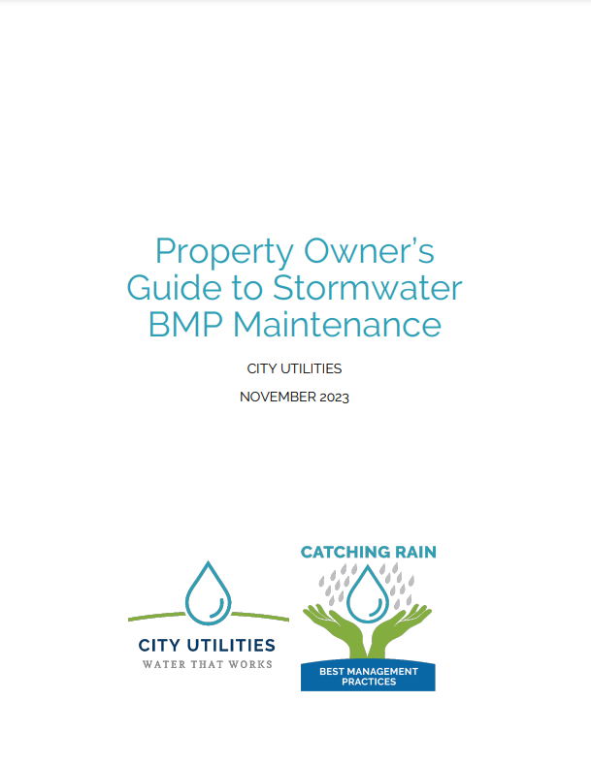
BMP Manual
Reference the Property Owner’s Guide to Stormwater BMP Maintenance on the City of Fort Wayne Catching Rain website
https://utilities.cityoffortwayne.org/education/catching-rain/bmp-inspection/

Slide 13
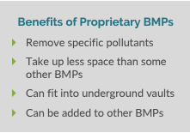
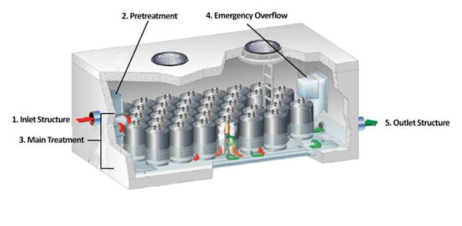
Underground Systems - Proprietary BMP Basics
What Are My Responsibilities?
Ongoing protection, inspection, and maintenance is important to the function of your BMP. Here are a few things to keep in mind:
BMPs located on your property according to the ‘Catching Rain BMP’ app must be inspected and cared for by you, the property owner. The requirements for inspection and maintenance presented in this document are supported by the City’s Ordinance in Chapter 53: Stormwater Management Department.
You can choose to hire others (like a landscape company) to perform inspection and maintenance activities, but you are ultimately responsible for inspection and maintenance.
City Utilities keeps track of your inspection and maintenance reports and may perform utility-led inspections when they see fit. If you don’t inspect and maintain your BMP, this violates the City’s Stormwater Ordinance and can result in fines, penalties, and requirements to fix your BMP.
Proprietary Best Management Practices (BMPs) remove pollutants from
stormwater by guiding the runoff through a bed of media like sand, compost,
or organic material. These BMPs are “proprietary” because they can be
designed to remove specific pollutant(s). They can target suspended solids
and particles, or they can aim to remove dissolved pollutants. The details of
your proprietary BMP should be provided by the manufacturer. Proprietary
BMPs will manage about 1-inch of stormwater and drain quickly after a
storm. Proprietary BMPs will be located in stormwater management
easements (SMEs), and will be easy to find using the ‘Catching Rain BMP’
app and typing in your property address.
Most proprietary BMPs will have five basic parts Most of these parts will be underground or contained within a vault. This requires access through a manhole, observation well, or inlet/outlet structure. Because there are different types of proprietary BMPs, inspection and maintenance will require the use of an owner’s manual and specific information from the manufacturer.
1. Inlet structures let water flow into the BMP.
2. Pretreatment areas remove trash, debris, and dirt from
stormwater flowing in. This helps to prevent clogging of the main treatment area.
3. The main treatment area is where stormwater is collected, so
the water can be cleaned and drain at a controlled speed.
4. Emergency overflows let water escape and flow around the
BMP during intense or long storms, without flooding the
surrounding area.
5. The outlet structure lets the cleaner water exit the BMP.

Slide 14
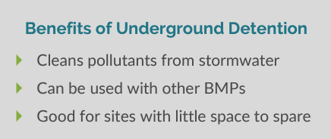
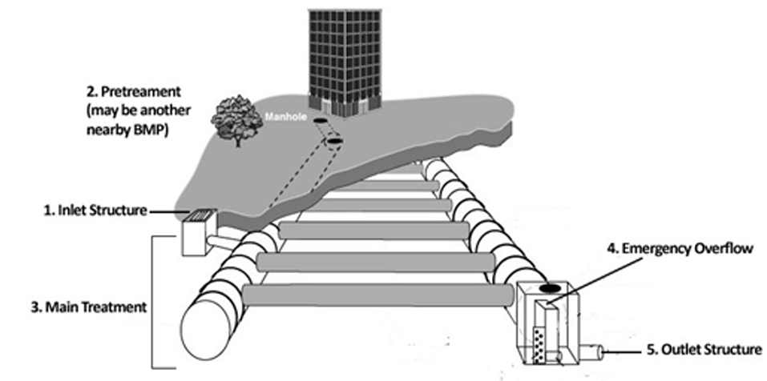
Underground Systems - Underground Detention Basics
What Are My Responsibilities?
Ongoing protection, inspection, and maintenance is important to the function of your BMP. Here are a few things to keep in mind:
BMPs located on your property according to the ‘Catching Rain BMP’ app must be inspected and cared for by you, the property owner. The requirements for inspection and maintenance presented in this document are supported by the City’s Ordinance in Chapter 53: Stormwater Management Department.
You can choose to hire others (like a landscape company) to perform inspection and maintenance activities, but you are ultimately responsible for inspection and maintenance.
City Utilities keeps track of your inspection and maintenance reports and may perform utility-led inspections when they see fit. If you don’t inspect and maintain your BMP, this violates the City’s Stormwater Ordinance and can result in fines, penalties, and requirements to fix your BMP.
Underground Detention is a Best Management Practice (BMP)
made of pipes and vaults that remove pollutants from
stormwater by storing it underground for a short amount of
time. The BMP lets the sediment (dirt) settle out of the water
before it is slowly released. Underground detention is a good
BMP to use when space is tight, and are commonly used under
parking lots or under grassed areas in common spaces. This
BMP is also good for flood control. Underground detention
BMPs will manage about 1-inch of stormwater and store
water for up to 48 hours. Underground detention BMPs will be located in stormwater management easements (SMEs), and will be easy to find using the ‘Catching Rain BMP’ app and typing in your property address.
Most underground detention BMP will have five basic parts (see the figure below). Most of these parts will be underground or contained within a vault, requiring access through a manhole.
1. Inlet structures let water flow into the BMP.
2. Pretreatment areas remove trash, debris, and dirt from
stormwater flowing in. This helps to prevent clogging of the main treatment area.
3. The main treatment area is where stormwater is collected, so
the water can be cleaned and drain at a controlled speed.
4. Emergency overflows let water escape and flow around the
BMP during intense or long storms, without flooding the
surrounding area.
5. The outlet structure lets the cleaner water exit the BMP.

Slide 15
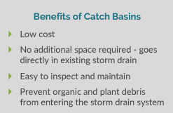
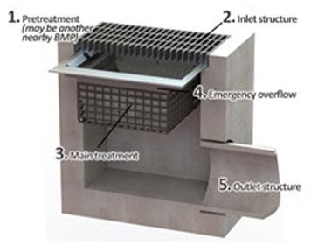
Underground Systems - Catch Basin Basics
What Are My Responsibilities?
Ongoing protection, inspection, and maintenance is important to the function of your BMP. Here are a few things to keep in mind:
BMPs located on your property according to the ‘Catching Rain BMP’ app must be inspected and cared for by you, the property owner. The requirements for inspection and maintenance presented in this document are supported by the City’s Ordinance in Chapter 53: Stormwater Management Department.
You can choose to hire others (like a landscape company) to perform inspection and maintenance activities, but you are ultimately responsible for inspection and maintenance.
City Utilities keeps track of your inspection and maintenance reports and may perform utility-led inspections when they see fit. If you don’t inspect and maintain your BMP, this violates the City’s Stormwater Ordinance and can result in fines, penalties, and requirements to fix your BMP.
Catch Basins are Best Management Practices (BMPs) that remove trash,
debris, and sediment from runoff directly at the storm drain. Some
catch basins can be built to absorb oils. These catch basins are usually
installed underground or in a vault. They are best used in combination
with other BMPs because they can reduce pollution before runoff gets
downstream. A catch basin can have an insert installed in it to remove
pollutants. Some catch basin inserts are designed to remove specific
pollutants, like activated carbon, porous polymer, or treated cellulose.
The details of your structure should be provided by the manufacturer.
Sumped structures will manage about 1-inch of stormwater and drain quickly after a storm. Sumped structures will be located in stormwater management easements (SMEs), and will be easy to find using the ‘Catching Rain BMP’ app and typing in your property address.
Most sumped structures will have five basic parts (see the figure below). Most of these parts will be underground or contained within a vault. This requires access through a manhole, observation well, or inlet/outlet structure. Because there are different types of sumped structures, inspection and maintenance will require the use of an owner’s manual and specific information from the manufacturer.
1. Inlet structures let water flow into the BMP.
2. Pretreatment areas remove trash, debris, and dirt from stormwater flowing in. This helps to prevent clogging of the main treatment area.
3. The main treatment area is where stormwater is collected, so the water can be cleaned and drain at a controlled speed.
4. Emergency overflows let water escape and flow around the BMP during intense or long storms, without flooding the surrounding area.
5. The outlet structure lets the cleaner water exit the BMP.

Slide 16
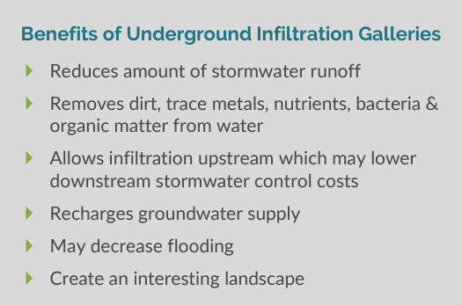
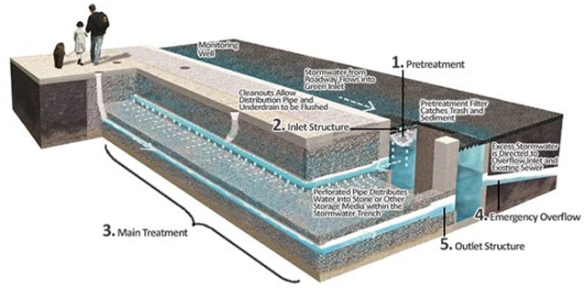
Underground Systems - Underground Infiltration Gallery Basics
What Are My Responsibilities?
Ongoing protection, inspection, and maintenance is important to the function of your BMP. Here are a few things to keep in mind:
BMPs located on your property according to the ‘Catching Rain BMP’ app must be inspected and cared for by you, the property owner. The requirements for inspection and maintenance presented in this document are supported by the City’s Ordinance in Chapter 53: Stormwater Management Department.
You can choose to hire others (like a landscape company) to perform inspection and maintenance activities, but you are ultimately responsible for inspection and maintenance.
City Utilities keeps track of your inspection and maintenance reports and may perform utility-led inspections when they see fit. If you don’t inspect and maintain your BMP, this violates the City’s Stormwater Ordinance and can result in fines, penalties, and requirements to fix your BMP.
Underground infiltration galleries (UIGs) are Best Management
Practices (BMPs) that catch and hold stormwater runoff in a structure
made of rock, stone, or clay. There, the stormwater soaks into the
ground over a couple of days. Infiltration galleries will manage about
1-inch of stormwater and should drain completely about 24 to 48
hours after a storm. Underground infiltration galleries will be located
in stormwater management easements (SMEs) and will be easy to
find using the ‘Catching Rain BMP’ app and typing in your property
address.
Most underground infiltration galleries will have five basic parts
(see the figure below):
1. Pretreatment areas remove trash, debris, and
dirt from stormwater flowing in. This helps to
prevent clogging of the main treatment area.
2. Inlet structures let water flow into the BMP.
3. The main treatment area is where stormwater
is collected, so the water can be cleaned and drain
at a controlled speed.
4. Emergency overflows let water escape and flow
around the BMP during intense or long storms,
without flooding the surrounding area.
5. The outlet structure lets the cleaner water exit
the BMP.

Slide 17
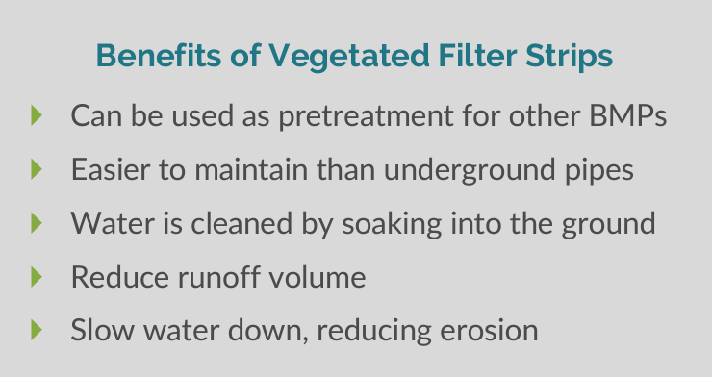
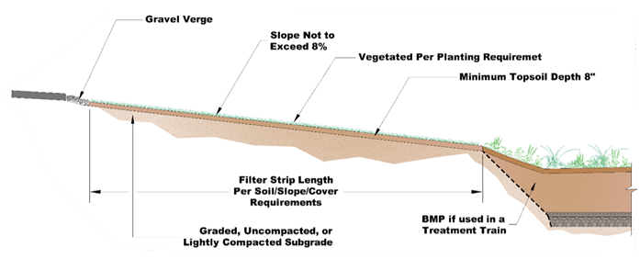
Linear Systems - Vegetated Filter Strip Basics
What Are My Responsibilities?
Ongoing protection, inspection, and maintenance is important to the function of your BMP. Here are a few things to keep in mind:
BMPs located on your property according to the ‘Catching Rain BMP’ app must be inspected and cared for by you, the property owner. The requirements for inspection and maintenance presented in this document are supported by the City’s Ordinance in Chapter 53: Stormwater Management Department.
You can choose to hire others (like a landscape company) to perform inspection and maintenance activities, but you are ultimately responsible for inspection and maintenance.
City Utilities keeps track of your inspection and maintenance reports and may perform utility-led inspections when they see fit. If you don’t inspect and maintain your BMP, this violates the City’s Stormwater Ordinance and can result in fines, penalties, and requirements to fix your BMP.
Vegetated Filter Strips are gently sloping Best Management
Practices (BMPs) with densely vegetated areas of native
plants. They slow down stormwater runoff and filter out
pollutants by letting the water soak into the ground. They
are usually installed as a pretreatment for another BMP. A
vegetated filter strip will manage about 1-inch of about 24
hours after a storm. Vegetated filter strips will be located
in stormwater management easements (SMEs), and will be
easy to find using the ‘Catching Rain BMP’ app and typing
in your property address.
Most vegetated filter strips will have five common
components (see the figure below):
1. Inlet structures let water flow into the BMP.
2. Pretreatment areas remove trash, debris, and
dirt from stormwater flowing in. This helps to
prevent clogging of the main treatment area.
3. The main treatment area is where
stormwater is collected, so the water
can be cleaned and drain at a controlled
speed.
4. Emergency overflows let water escape and
flow around the BMP during intense or long
storms, without flooding the surrounding area.
5. The outlet structure lets the cleaner water exit the BMP.

Slide 18
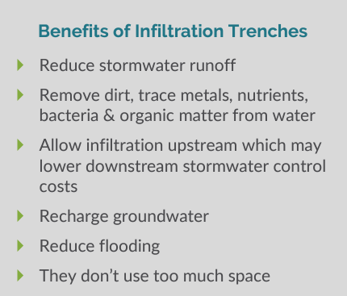
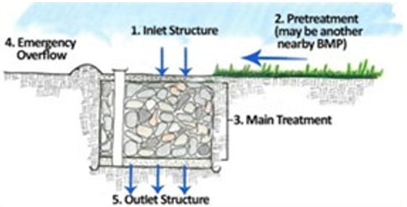
Linear Systems - Infiltration Trench Basics
What Are My Responsibilities?
Ongoing protection, inspection, and maintenance is important to the function of your BMP. Here are a few things to keep in mind:
BMPs located on your property according to the ‘Catching Rain BMP’ app must be inspected and cared for by you, the property owner. The requirements for inspection and maintenance presented in this document are supported by the City’s Ordinance in Chapter 53: Stormwater Management Department.
You can choose to hire others (like a landscape company) to perform inspection and maintenance activities, but you are ultimately responsible for inspection and maintenance.
City Utilities keeps track of your inspection and maintenance reports and may perform utility-led inspections when they see fit. If you don’t inspect and maintain your BMP, this violates the City’s Stormwater Ordinance and can result in fines, penalties, and requirements to fix your BMP.
Infiltration Trenches are Best Management Practices (BMPs) that capture stormwater and let it soak into the soil. These trenches are excavated and filled with stone. The stormwater gathers in the trench, flows through the stone, and pollutants are filtered out. Once filtered, the water goes back into the local stream or into the stormwater system. Some infiltration trenches are covered with topsoil and planted with grass. Infiltration trenches will manage about 1-inch of stormwater. They should drain completely about 6 to 72 hours after a storm. Infiltration trenches will be located in stormwater management easements (SMEs), and will be easy to find using the ‘Catching Rain BMP’ app and typing in your property address.
Most infiltration trenches will have five basic parts (see the figure below):
1. Inlet structures let water flow into the BMP.
2. Pretreatment areas remove trash, debris, and dirt
from stormwater flowing in. This helps to prevent
clogging of the main treatment area.
3. The main treatment area is where stormwater is
collected, so the water can be cleaned and drain at a
controlled speed.
4. Emergency overflows let water escape and flow around the
BMP during intense or long storms, without flooding the
surrounding area.
5. The outlet structure lets the cleaner water exit the BMP.

Slide 19
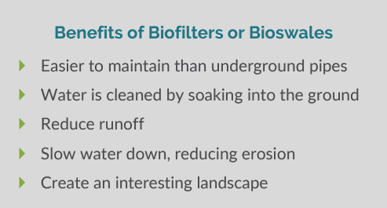
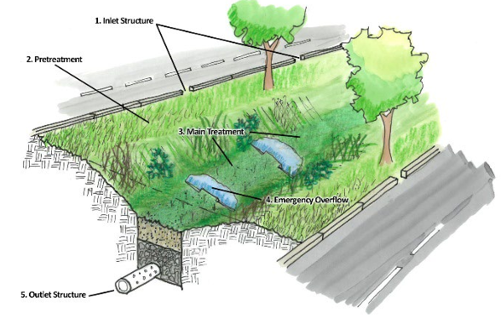
Linear Systems - Biofilter or Bioswale Basics
What Are My Responsibilities?
Ongoing protection, inspection, and maintenance is important to the function of your BMP. Here are a few things to keep in mind:
BMPs located on your property according to the ‘Catching Rain BMP’ app must be inspected and cared for by you, the property owner. The requirements for inspection and maintenance presented in this document are supported by the City’s Ordinance in Chapter 53: Stormwater Management Department.
You can choose to hire others (like a landscape company) to perform inspection and maintenance activities, but you are ultimately responsible for inspection and maintenance.
City Utilities keeps track of your inspection and maintenance reports and may perform utility-led inspections when they see fit. If you don’t inspect and maintain your BMP, this violates the City’s Stormwater Ordinance and can result in fines, penalties, and requirements to fix your BMP.
Biofilters or Bioswales are Best Management Practices
(BMPs) that clean pollutants from stormwater by letting
the water soak into the ground. These BMPs are broad
and shallow with thick, native grass. The bottom acts as
a natural pipe that guides water from a road, parking lot,
or other properties. When the water is in the swale, it can
soak into the ground and pollutants can filter out. A
biofilter or bioswale will manage about 1-inch of
stormwater and should drain completely about 24 hours
after a storm. Biofilters or bioswales will be located in
stormwater management easements (SMEs), and will be
easy to find using the ‘Catching Rain BMP’ app and typing in your property address.
Most biofilters or bioswales will have five common components (see the figure below):
1. Inlet structures let water flow into the BMP.
2. Pretreatment areas remove trash, debris, and dirt
from stormwater flowing in. This helps to prevent
clogging of the main treatment area.
3. The main treatment area is where stormwater is
collected, so the water can be cleaned and drain at
a controlled speed.
4. Emergency overflows let water escape and flow
around the BMP during intense or long storms, without
flooding the surrounding area.
5. The outlet structure lets the cleaner water exit the BMP.

Slide 20
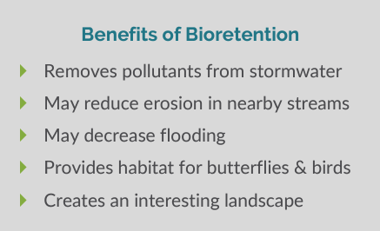
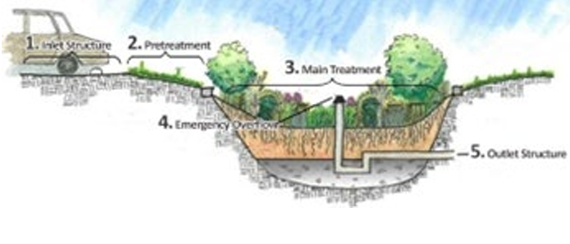
Basin Systems - Bioretention Basics
What Are My Responsibilities?
Ongoing protection, inspection, and maintenance is important to the function of your BMP. Here are a few things to keep in mind:
BMPs located on your property according to the ‘Catching Rain BMP’ app must be inspected and cared for by you, the property owner. The requirements for inspection and maintenance presented in this document are supported by the City’s Ordinance in Chapter 53: Stormwater Management Department.
You can choose to hire others (like a landscape company) to perform inspection and maintenance activities, but you are ultimately responsible for inspection and maintenance.
City Utilities keeps track of your inspection and maintenance reports and may perform utility-led inspections when they see fit. If you don’t inspect and maintain your BMP, this violates the City’s Stormwater Ordinance and can result in fines, penalties, and requirements to fix your BMP.
Bioretention is a Best Management Practice (BMP) that cleans
pollution from stormwater. Bioretention areas are built as
shallow, sunken areas that catch stormwater from surrounding
property. The water soaks into the soil of the bioretention area.
A common bioretention area will easily handle rainfall from
small storms, and should drain completely 24-48 hours after a
storm. Bioretention is a great BMP to be used in median strips,
parking lot islands, and landscaped swales. Bioretention areas
will be located in stormwater management easements (SMEs),
and will be easy to find using the ‘Catching Rain BMP’ app and
typing in your property address.
Most bioretention areas will have five basic parts (see the figure below):
1. Inlet structures let water flow into
the BMP.
2. Pretreatment areas remove trash,
debris, and dirt from stormwater
flowing in. This helps to prevent clogging
of the main treatment area.
3. The main treatment area is where stormwater is
collected, so the water can be cleaned and drain at a
controlled speed.
4. Emergency overflows let water escape and flow around the
BMP during intense or long storms, without flooding the surrounding area.
5. The outlet structure lets the cleaner water exit the BMP.

Slide 21
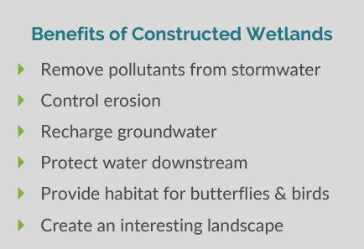
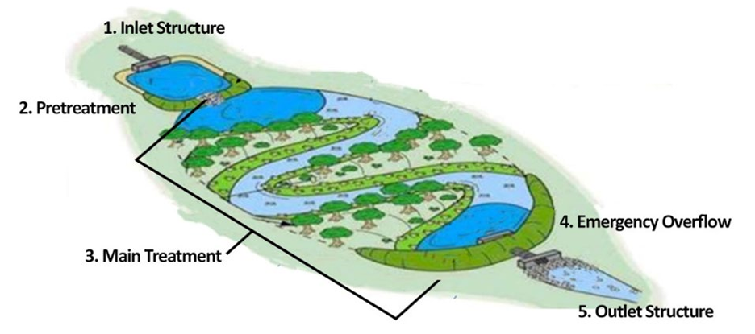
Basin Systems - Constructed Wetland Basics
What Are My Responsibilities?
Ongoing protection, inspection, and maintenance is important to the function of your BMP. Here are a few things to keep in mind:
BMPs located on your property according to the ‘Catching Rain BMP’ app must be inspected and cared for by you, the property owner. The requirements for inspection and maintenance presented in this document are supported by the City’s Ordinance in Chapter 53: Stormwater Management Department.
You can choose to hire others (like a landscape company) to perform inspection and maintenance activities, but you are ultimately responsible for inspection and maintenance.
City Utilities keeps track of your inspection and maintenance reports and may perform utility-led inspections when they see fit. If you don’t inspect and maintain your BMP, this violates the City’s Stormwater Ordinance and can result in fines, penalties, and requirements to fix your BMP.
Constructed Wetlands can act as Best Management Practices
(BMPs) that catch stormwater runoff and let it go over about
40 hours. Wetlands should be at least 18-inches deep and hold
water. Constructed wetlands differ from a wet extended
detention basin because it isn’t as deep. Plants in the wetland
remove pollution from runoff by filtering the water through
their roots. Wetlands let the stormwater settle, along with any
pollution. This means that polluted water doesn’t make it to
the storm drain or stream. Constructed wetlands will be located
in stormwater management easements (SMEs), and will be easy
to find using the ‘Catching Rain BMP’ app and typing in your
property address.
Most constructed wetlands will have five basic parts (see the figure below):
1. Inlet structures let water flow into the BMP.
2. Pretreatment areas remove trash, debris, and
dirt from stormwater flowing in. This helps to
prevent clogging of the main treatment area.
3. The main treatment area is where stormwater
is collected, so the water can be cleaned and drain
at a controlled speed.
4. Emergency overflows let water escape and flow
around the BMP during intense or long storms,
without flooding the surrounding area.
5. The outlet structure lets the cleaner water exit the BMP.

Slide 22
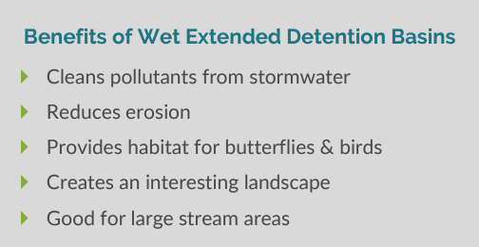
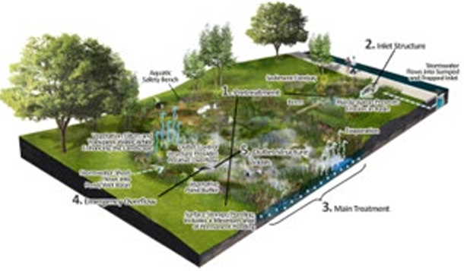
Basin Systems - Wet Extended Detention Basin Basics
What Are My Responsibilities?
Ongoing protection, inspection, and maintenance is important to the function of your BMP. Here are a few things to keep in mind:
BMPs located on your property according to the ‘Catching Rain BMP’ app must be inspected and cared for by you, the property owner. The requirements for inspection and maintenance presented in this document are supported by the City’s Ordinance in Chapter 53: Stormwater Management Department.
You can choose to hire others (like a landscape company) to perform inspection and maintenance activities, but you are ultimately responsible for inspection and maintenance.
City Utilities keeps track of your inspection and maintenance reports and may perform utility-led inspections when they see fit. If you don’t inspect and maintain your BMP, this violates the City’s Stormwater Ordinance and can result in fines, penalties, and requirements to fix your BMP.
Wet Extended Detention Basins are Best Management
Practices (BMPs) that removes pollutants from
stormwater by storing it in a basin for a short amount
of time. The detention basin lets the sediment (dirt)
settle out of the water before it is released. Plants in a
wet extended detention basin remove pollutants
through their roots and leaves. This BMP is also good
for flood control. Wet extended detention basins will
have a permanent pool of water. Wet extended
detention basins will manage about 1-inch of
stormwater and store water for up to 48 hours. Wet extended detention basins will be located in stormwater management easements (SMEs), and will be easy to find using the ‘Catching Rain BMP’ app and typing in your property address.
Most wet extended detention basins will have five basic parts (see the figure below):
1. Pretreatment areas remove trash, debris, and dirt from
stormwater flowing in. This helps to prevent clogging of the main treatment area.
2. Inlet structures let water flow into the BMP.
3. The main treatment area is where stormwater is collected, so
the water can be cleaned and drain at a controlled speed.
4. Emergency overflows let water escape and flow around the
BMP during intense or long storms, without flooding the
surrounding area.
5. The outlet structure lets the cleaner water exit the BMP.

Slide 23
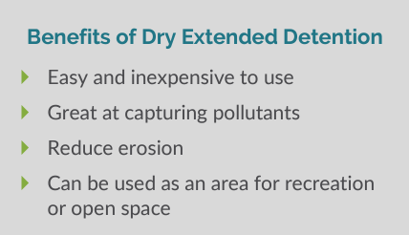
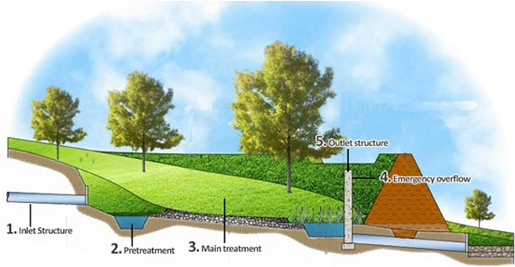
Basin Systems - Dry Extended Detention Basin Basics
What Are My Responsibilities?
Ongoing protection, inspection, and maintenance is important to the function of your BMP. Here are a few things to keep in mind:
BMPs located on your property according to the ‘Catching Rain BMP’ app must be inspected and cared for by you, the property owner. The requirements for inspection and maintenance presented in this document are supported by the City’s Ordinance in Chapter 53: Stormwater Management Department.
You can choose to hire others (like a landscape company) to perform inspection and maintenance activities, but you are ultimately responsible for inspection and maintenance.
City Utilities keeps track of your inspection and maintenance reports and may perform utility-led inspections when they see fit. If you don’t inspect and maintain your BMP, this violates the City’s Stormwater Ordinance and can result in fines, penalties, and requirements to fix your BMP.
Dry Extended Detention Basins are Best Management
Practices (BMPs) that collect and store stormwater.
The basins remove pollution and control flooding. A
dry extended detention basin will manage about 1-inch
of stormwater and drain completely about 40 hours
after a storm. Dry extended detention basins will be
located in stormwater management easements (SMEs),
and will be easy to find using the ‘Catching Rain BMP’
app and typing in your property address.
Most dry extended detention basins will have five basic
parts (see the figure below):
1. Inlet structures let water flow into the BMP.
2. Pretreatment areas remove trash, debris, and
dirt from stormwater flowing in. This helps to
prevent clogging of the main treatment area.
3. The main treatment area is where
stormwater is collected, so the water can
be cleaned and drain at a controlled speed.
4. Emergency overflows let water escape
and flow around the BMP during intense
or long storms, without flooding the
surrounding area.
5. The outlet structure lets the cleaner water
exit the BMP.

Slide 24
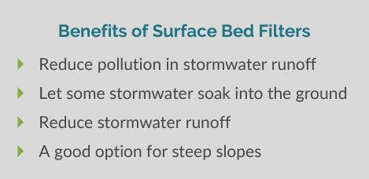
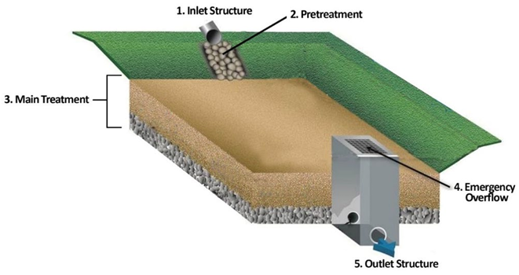
Basin Systems - Surface Bed Filter Basics
What Are My Responsibilities?
Ongoing protection, inspection, and maintenance is important to the function of your BMP. Here are a few things to keep in mind:
BMPs located on your property according to the ‘Catching Rain BMP’ app must be inspected and cared for by you, the property owner. The requirements for inspection and maintenance presented in this document are supported by the City’s Ordinance in Chapter 53: Stormwater Management Department.
You can choose to hire others (like a landscape company) to perform inspection and maintenance activities, but you are ultimately responsible for inspection and maintenance.
City Utilities keeps track of your inspection and maintenance reports and may perform utility-led inspections when they see fit. If you don’t inspect and maintain your BMP, this violates the City’s Stormwater Ordinance and can result in fines, penalties, and requirements to fix your BMP.
Surface Bed Filters are Best Management Practices (BMPs)
that clean stormwater by filtering it through a sand bed.
Runoff is guided into a bed of sand where it is collected
and cleaned. The water is collected, filtered through the
sand where it is cleaned, and released to a stream or
stormwater system. There are three types of surface bed
filters; 1) Underground sand filters that use several
chambers, 2) sand filters installed on the edge of an
impervious surface, like a parking lot, and 3) pocket sand
filters used specifically for small site projects (for these, stormwater is pretreated by a sediment basin or filter strip before entering a pocket sand filter). Surface bed filters will manage about 1-inch of stormwater and drain 1 to 2 days after a storm. Surface bed filters will be located in stormwater management easements (SMEs), and will be easy to find using the ‘Catching Rain BMP’ app and typing in your property address.
Most surface bed filters will have five basic parts (see the figure below):
1. Inlet structures let water flow into the BMP.
2. Pretreatment areas remove trash, debris, and dirt
from stormwater flowing in. This helps to prevent
clogging of the main treatment area.
3. The main treatment area is where
stormwater is collected, so the water can be cleaned
and drain at a controlled speed.
4. Emergency overflows let water escape and flow around the
BMP during intense or long storms, without flooding the
surrounding area.
5. The outlet structure lets the cleaner water exit the BMP.

Slide 25
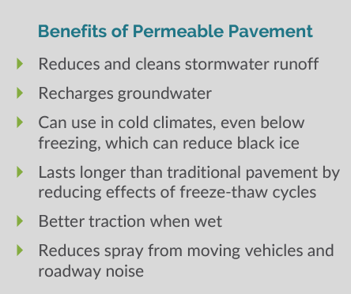
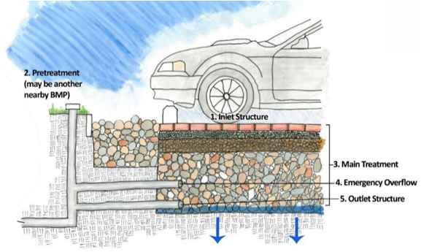
Pavement Systems - Permeable Pavement Basics
What Are My Responsibilities?
Ongoing protection, inspection, and maintenance is important to the function of your BMP. Here are a few things to keep in mind:
BMPs located on your property according to the ‘Catching Rain BMP’ app must be inspected and cared for by you, the property owner. The requirements for inspection and maintenance presented in this document are supported by the City’s Ordinance in Chapter 53: Stormwater Management Department.
You can choose to hire others (like a landscape company) to perform inspection and maintenance activities, but you are ultimately responsible for inspection and maintenance.
City Utilities keeps track of your inspection and maintenance reports and may perform utility-led inspections when they see fit. If you don’t inspect and maintain your BMP, this violates the City’s Stormwater Ordinance and can result in fines, penalties, and requirements to fix your BMP.
Permeable Surfaces are Best Management Practices (BMPs) that
let stormwater flow into the holes in the pavement surface.
From there, the water soaks into the soil below. Permeable
surfaces can consist of modular pavers, concrete grids, pervious
concrete, porous asphalt, and cellular confinement systems.
Permeable surfaces usually manage about 1-inch of stormwater.
The permeable surface should be dry about 2 hours after a storm.
Permeable surface areas will be located in stormwater
management easements (SMEs), and will be easy to find using
the ‘Catching Rain BMP’ app and typing in your property address.
Most permeable surfaces will have five basic parts (see the figure
below):
1. Inlet structures let water flow into the BMP.
2. Pretreatment areas remove trash, debris, and
dirt from stormwater flowing in. This helps to
prevent clogging of the main treatment area.
3. The main treatment area is where stormwater is
collected, so the water can be cleaned and drain at a
controlled speed.
4. Emergency overflows let water escape and flow
around the BMP during intense or long storms, without
flooding the surrounding area.
5. The outlet structure lets the cleaner water exit
the BMP.

Slide 26
BMPs on your property
What are Your Responsibilities Once Your BMP is Located?
Owner:
Protect your BMP and related components from development, encroachment, and damage
Maintain and protect access routes, so your BMP is accessible from a public roadway
At a minimum, conduct and document inspections and maintenance annually
Follow guidelines in the BMP inspection forms found in Section 5 of the BMP manual
Submit required information to the City via the ‘Catching Rain BMP’ app
App explained in further detail in later slides
Utility:
We are here to help - contact City Utilities with questions about your BMP
stormwater@cityoffortwayne.org
Phone: 311 or (260) 427-8311

Slide 27
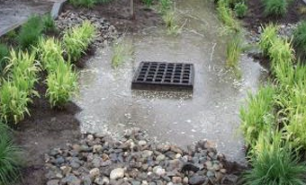
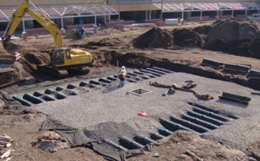
BMPs on your property (cont.)
Can You Make Changes to the BMP on Your Property?
You CAN make changes to the “look” of your BMP within the requirements and guidance provided in Section 5 of the Manual.
You CANNOT make any changes to your stormwater BMP that will degrade or alter its functionality.

Slide 28
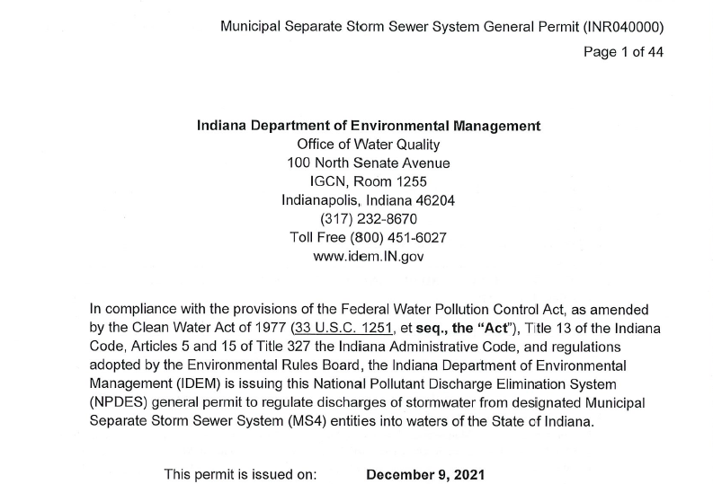
Fort Wayne’s Plan for Stormwater Measures / BMPs
Improve Implementation of Construction / Effectiveness of Plans
Improve BMP’s Useful Life
Improve Review and Reporting
IDEM MS4GP requires all Post Construction BMPs to be inspected
Fort Wayne’s BMP Inspection Program will require all BMP Owners to perform annual inspections of their BMPs

Slide 29
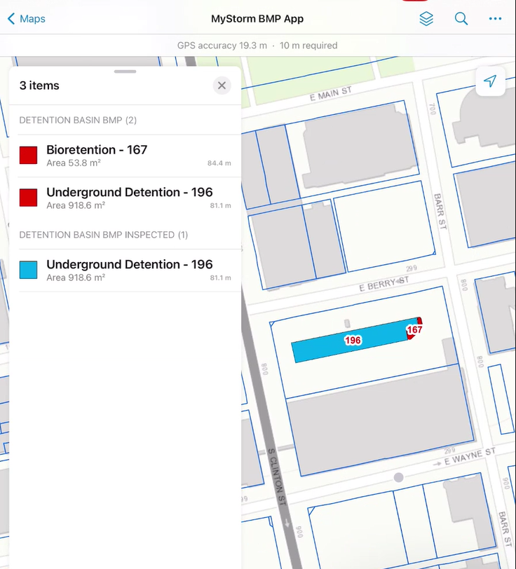
Administering Inspection “Catching Rain BMP" app
Allows users to inspect their assets
Mobile devices with Cellular / Wifi connection
Utilizes “ArcGIS Field Maps” and “ArcGIS Survey 123”
Catching Rain BMP app

Slide 30
Downloading the “Catching Rain BMP” Tool
Open the app store on your mobile device.
Search for the below 2 apps, download and install both.
ArcGIS Field Maps
ArcGIS Survey 123
Catching Rain BMP app

Slide 31
How to Use “Catching Rain BMP” Tools (cont.)
Scan the QR Code with your phone camera to open the Catching Rain BMP app.
If you are taken to a login screen, Click → Skip Sign In.
Your screen will open to a default map.
Click the arrow icon within the app, and the map will move to your current location.
You can also click the search icon and enter your address to see that specific property
Note: if you can’t see a BMP on your property, try zooming out on the map! Larger sites may have BMPs that are spread out, or have multiple BMPs
Catching Rain BMP app

Slide 32
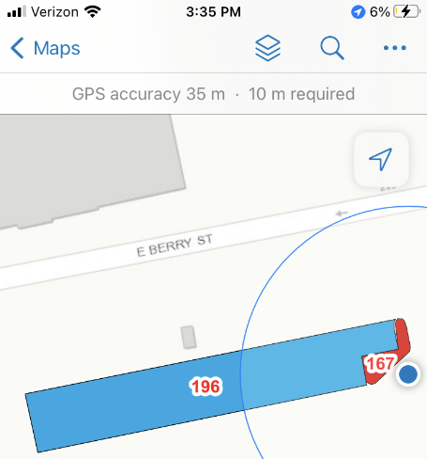
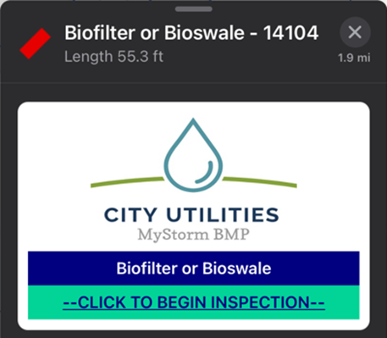
How to Use “Catching Rain BMP” Tool (cont.)
CHOOSE A BMP
RED = needs inspected
BLUE = inspection has been submitted
Click on a BMP on the map that you want to inspect.
Note: You may have more than one BMP on your property.
Select “CLICK TO BEGIN INSPECTION”
a. This will open Survey123.
Example of Two BMPs on Property
Example of Selected BMP

Slide 33
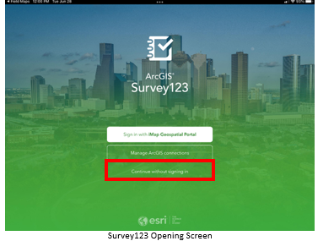
How to Use “Catching Rain BMP” Tool (cont.)
BMP INSPECTION
Once the link is clicked, it will launch the Survey123 app.
Click “Continue without Signing In”.

Slide 34
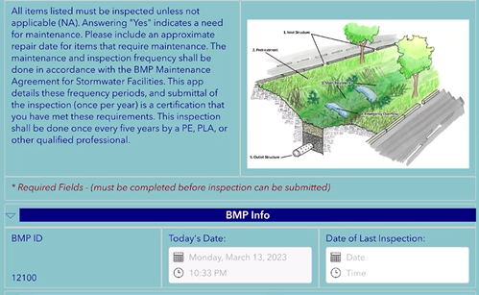
Recording an Inspection
Brief instructions are on the top of the page.
Enter the date of the inspection

Slide 35
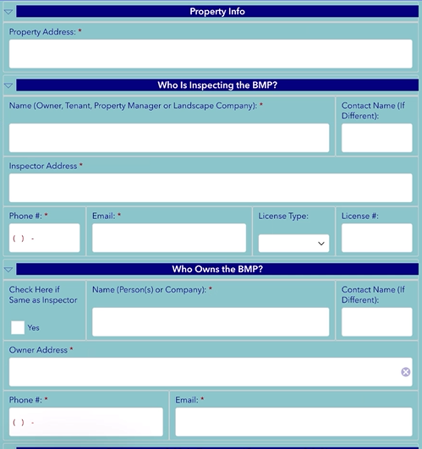
Recording an Inspection (cont.)
Enter the address of the property
Enter who’s inspecting the BMP
Enter who owns the BMP

Slide 36
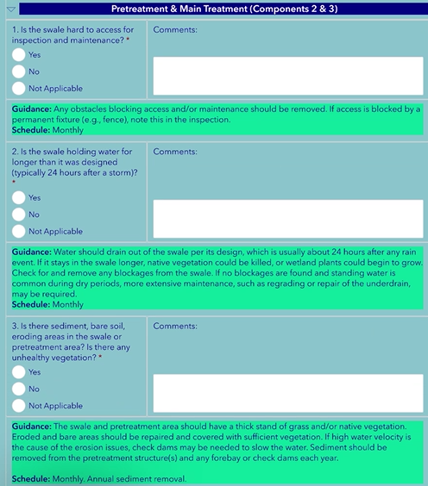
Recording an Inspection (cont.)
Fill out Pretreatment and Main Treatment components
NOTICE
If you answer “YES”
Something may need addressed

Slide 37
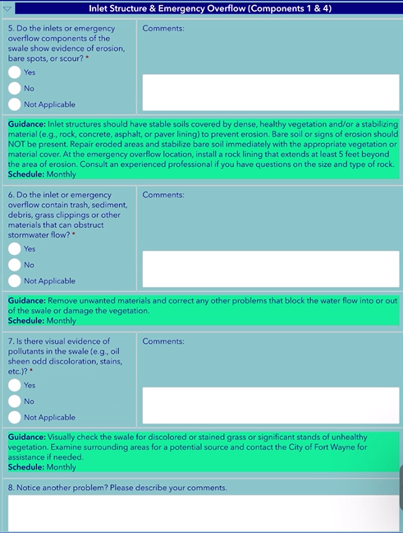
Recording an Inspection (cont.)
Fill out Inlet Structure & Emergency Overflow Components

Slide 38
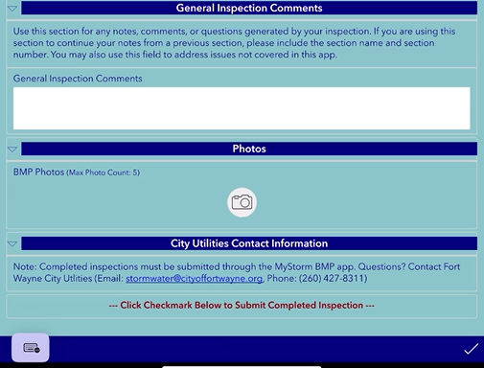
Recording an Inspection (cont.)
Fill General Inspection Comments
Add photos if necessary
Click checkmark to submit Inspection.

Slide 39
Inspection App monitoring
Fort Wayne will review inspections
Red flags will alert us on problems that may need to looked into
We will follow up with BMP Owners if inspections are not completed

Slide 40
BMP Success Factors
There are 4 BMP success factors to look out for while performing inspections
Vegetation
Two-day drain time
Protection
Cleanliness
These 4 success factors are important to keeping your BMP functioning as it was designed to
These can be used as “performance goals” when inspecting your BMPs

Slide 41
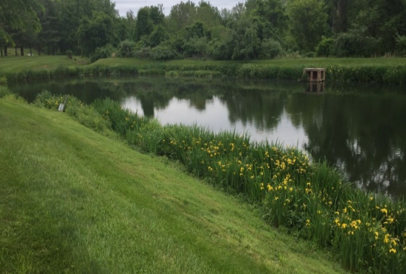
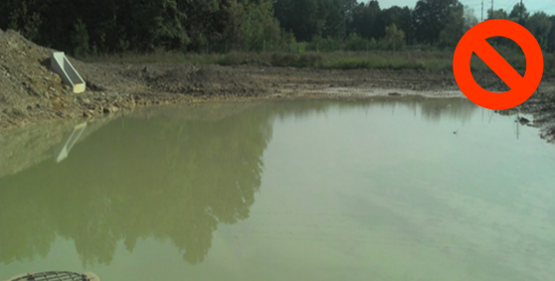
Vegetation
Vegetation, if present, should be healthy and maintained
There should be no bare soil present
Vegetation should not be overgrown or excessively weedy

Slide 42
Two-day Drain Time
Most BMPs should completely drain stormwater within 48 hours
Longer drain times can occur during periods of extended or frequent rains
Repeated instances of standing water can indicate clogs or other problems within your BMP

Slide 43
Protection
BMPs must be protected from damage that could occur due to pedestrians, vehicles, heavy equipment, and animals
BMPs cannot be used as storage for vehicles, heavy equipment, waste, dirt, or mulch

Slide 44
Cleanliness
The area around a BMP should be kept clean
There should be no sediment, litter, or stored pollutants in the BMP or its drainage area

Slide 45
What maintenance is needed between inspections?
Grass has grown over this inlet and should be cut back to allow water to enter the inlet.
Debris and leaf litter are blocking this inlet. Remove this material to allow water to enter the inlet.

Slide 46
What maintenance is needed between inspections? (cont)
Please Note: These inspections are a collaboration between City Utilities and YOU. Please don’t hesitate to reach out if you have any questions or need any guidance maintaining your BMP.
This pretreatment area is full of sediment that should be removed. Look for a source, like an eroded area. Larger jobs may require a contractor and/or special equipment.

Slide 47
What maintenance is needed between inspections? (cont)
Overgrown vegetation, especially invasive plants like cattails, should be removed and replaced with the correct plantings. Larger jobs may require a contractor and/or special equipment.
Erosion is present in the pretreatment area to this bioswale. New vegetation, additional soil, and/or other measures should be installed.

Slide 48
Practice: What maintenance is needed?
Filter cartridges were not replaced per manufacturers specifications and are overfilled with sediment. Entire Proprietary BMP will need to be vacuumed out and dried, and filter will need replaced.

Slide 49
Inspecting your stormwater BMP annually
INSPECTION TYPE | INSPECTION GUIDANCE | DOCUMENTATION PROCEDURES
Routine Operational Inspections | Often, and generally when landscaping activities are being performed at the property and after storms and snowmelt events | Documentation of these inspections is not required; however, it is a good idea to document larger-scale maintenance activities to keep track of what has been done and the costs (keep receipts if possible)
Regulatory-Required Formal Inspections | Submit annually by October 1st each year Performed by the owner (or individual designated by the owner) who is familiar with the purpose and basic function of the BMP Once every five years, the inspection needs to be conducted by either a PE, PLA, or other qualified professional | Must use the BMP Guidance Sheets and BMP Inspection Forms associated with your type of BMP (located in Section 5 of this Manual and on the ‘Catching Rain BMP’ app) The completed inspection forms and indication of maintenance performed must be submitted via the ‘Catching Rain BMP’ app by October 1st each year

Slide 50
Questions?
stormwater@cityoffortwayne.org
Phone: 311 or (260) 427-8311
Charlie Cochran – SWPPP Program Manager
260-427-1062
Charlie.Cochran@cityoffortwayne.org
Hannah Allen – Watershed Management and Sustainability
260-427-5021
Hannah.Allen@cityoffortwayne.org
Catching Rain BMP app

