Slide 1
Tamarack Storm Improvement – Phase 1
Tamarack and Blum Neighborhoods
Public Meeting
June 9th , 2025

Slide 2
Meeting Agenda
City Utilities – Stormwater Program
Neighborhood Drainage History
Drainage Issues
Proposed Solution
Schedule
Question and Answers
Small Group Discussion/Detailed Drawing Review

Slide 3
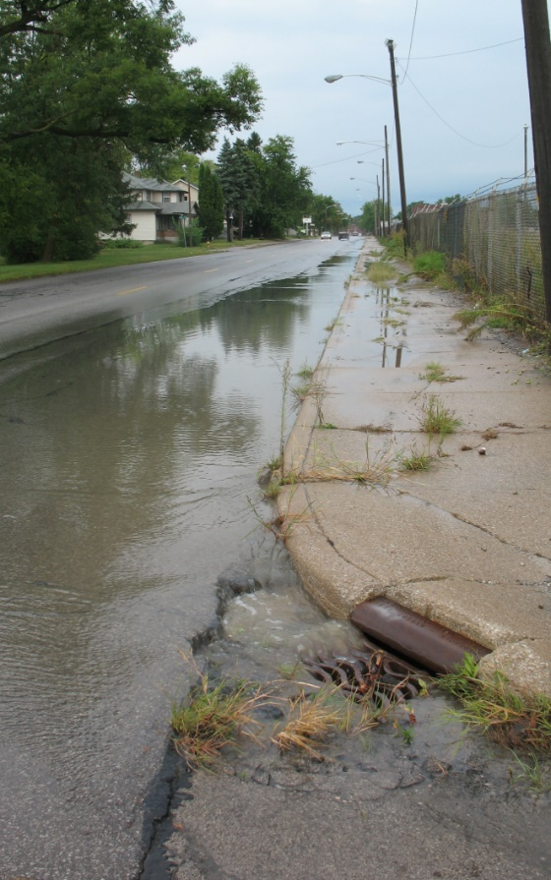
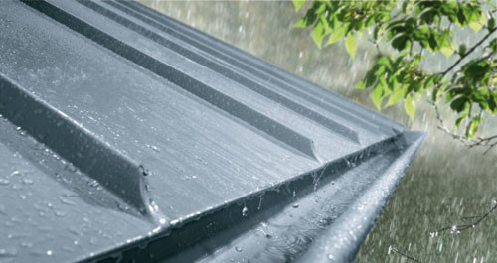
History of Stormwater Utility
Stormwater Utility established - 1991
NPDES Permit Phase II implementation - 2004

Slide 4
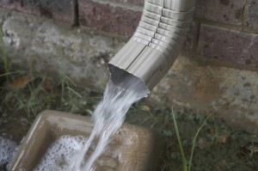
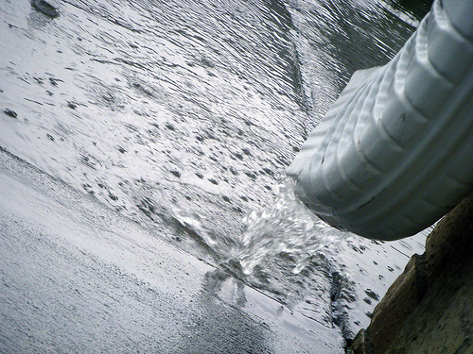
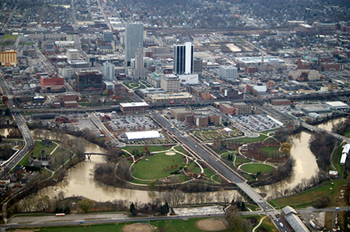
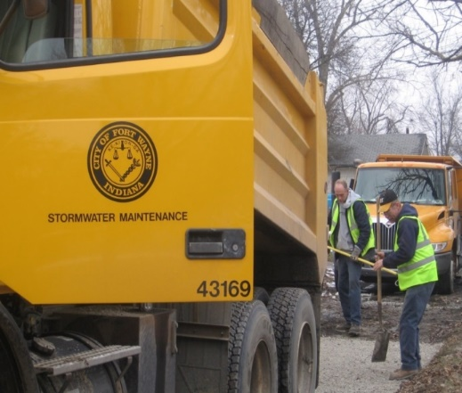
What does the Stormwater Utility do?
Every property contributes to runoff
Property Protection
Water Quality Protection

Slide 5
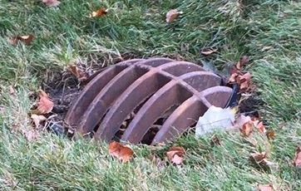
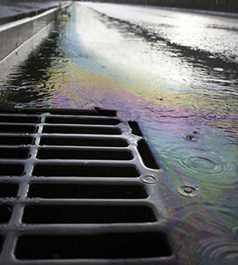
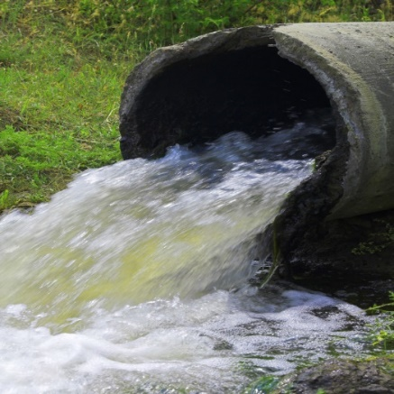
2020 Stormwater System Size
691 miles of storm pipe
74 miles of major ditches
20,503 inlets
756 catch basins
10,489 storm manholes
Detention facilities
92 sq. miles service area
Notes:
As you can see
We have very large system within city
This is one of the reasons we ask residents to keep their inlets and catch basins clear of debris.
21,000 inlets and catch basins.

Slide 6
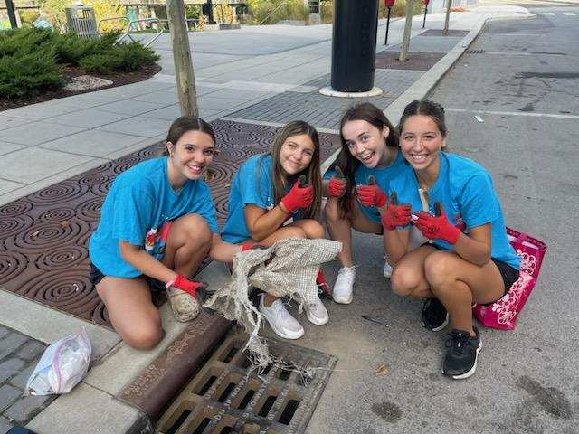
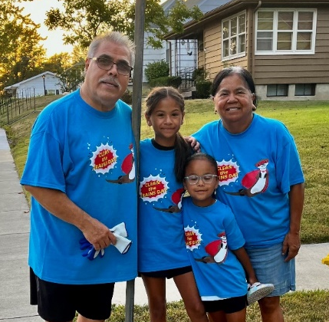
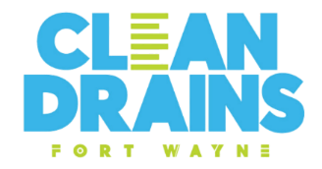
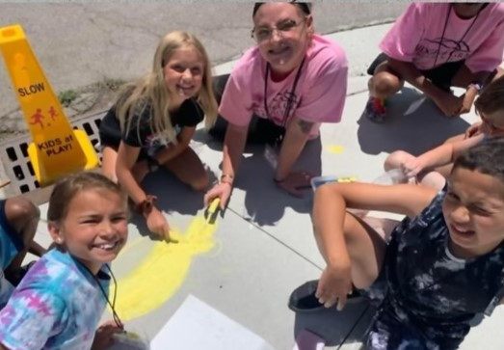
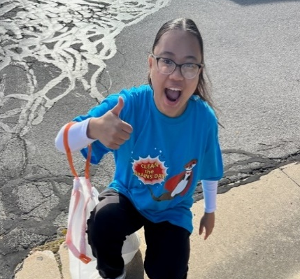
Clean Drains Fort Wayne 2025
BE A STORM DRAINER!
Be a lcoal hero. Help clear trash and debris from your storm drains to help keep our rivers healthy and to prevent flooding in your neighborhoods!
Register today and receive a FREE cleaning kit and t-shirts for you, family and friends!
ONLY RAIN IN THE DRAIN.
CleanDrainsintheFort.org

Slide 7

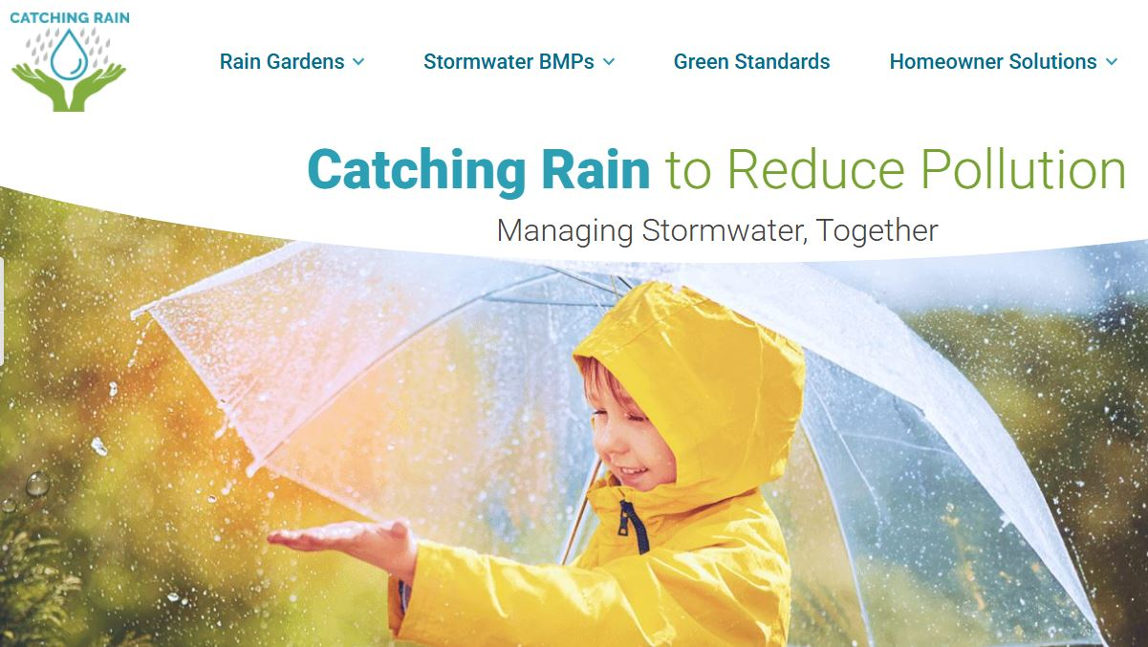
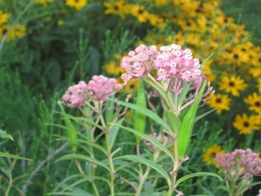


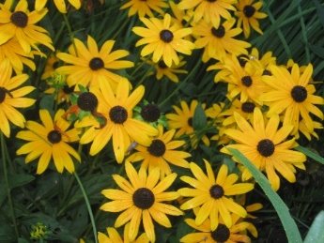

CATCHING RAIN
CatchingRainFW.org
-Build & register your rain garden
-Rain Garden workshop classes
-Learn stormwater management practices

Slide 8
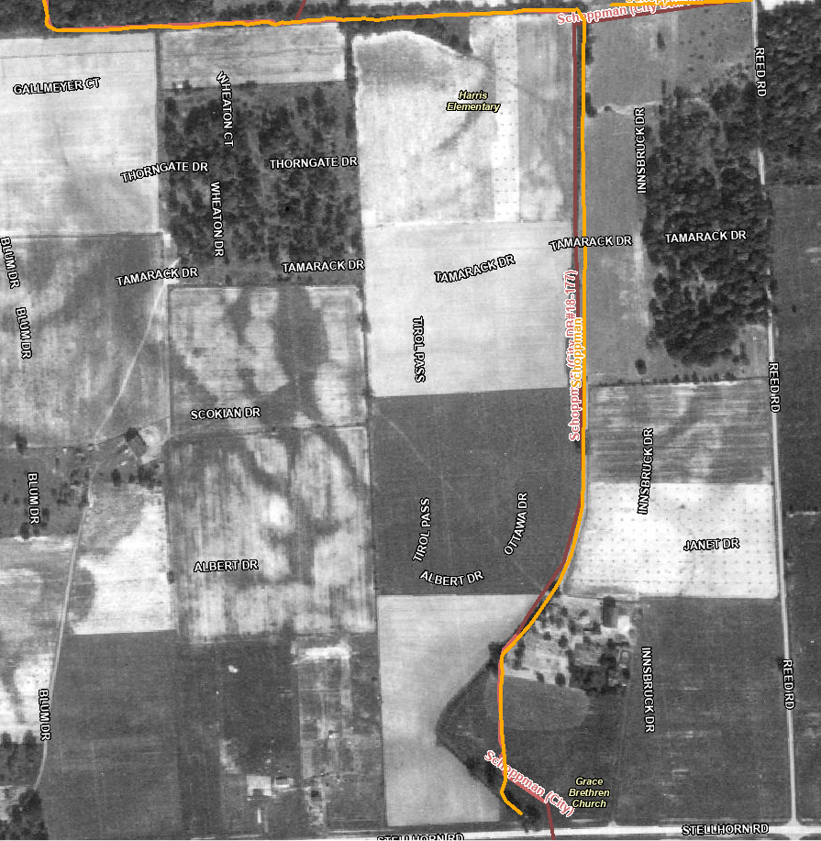
Schoppman Drain History
1938- Aerial

Slide 9
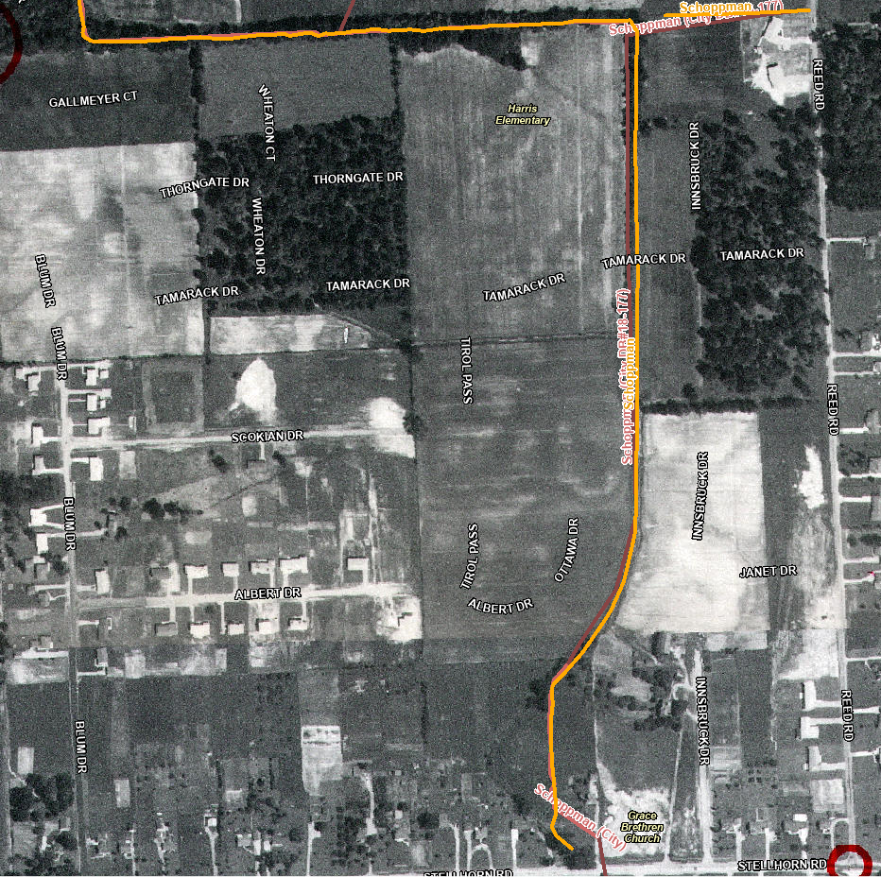
Bullerman Drain History
1957- Aerial

Slide 10
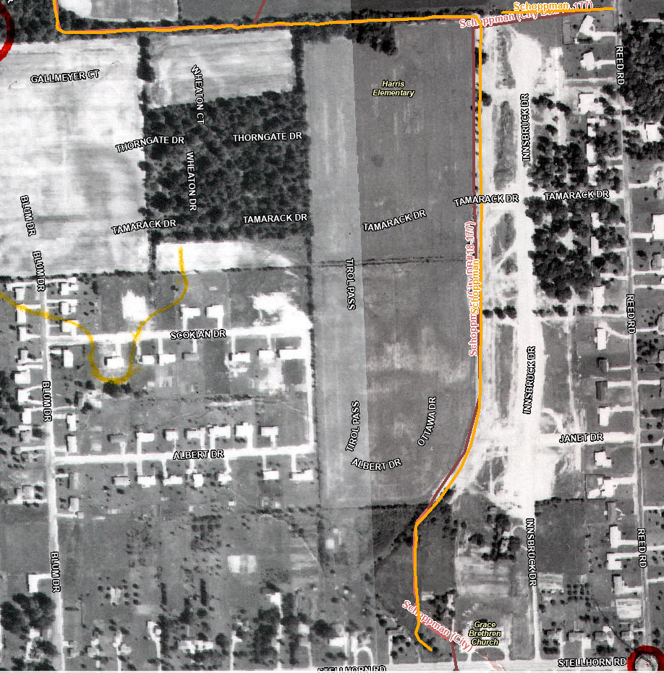
Bullerman Drain History
1964- Aerial

Slide 11
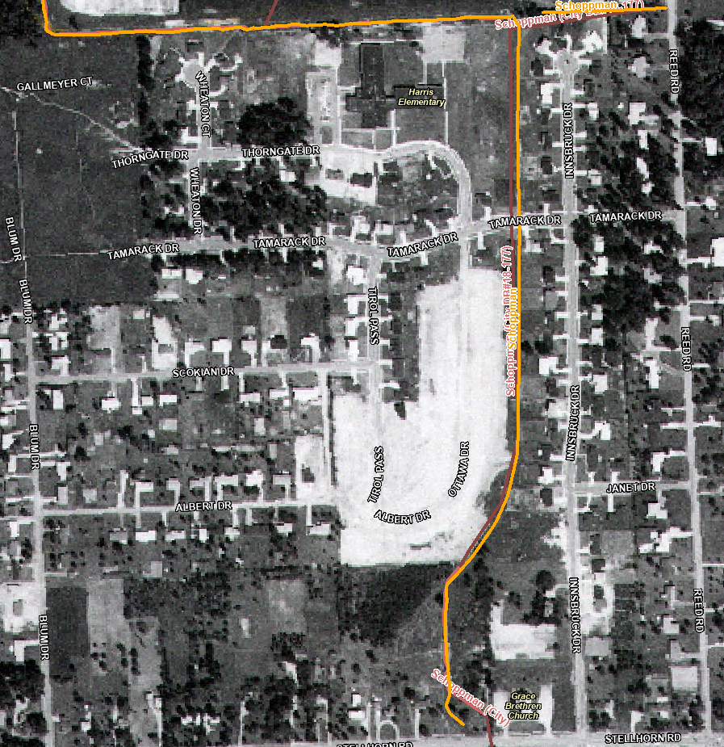
Bullerman Drain History
1972- Aerial

Slide 12
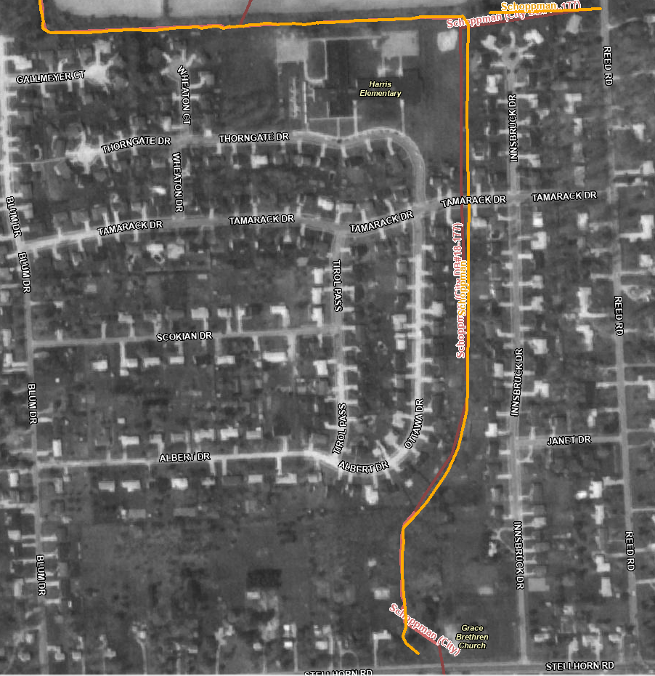
Bullerman Drain History
1986- Aerial
Drain watershed developed

Slide 13
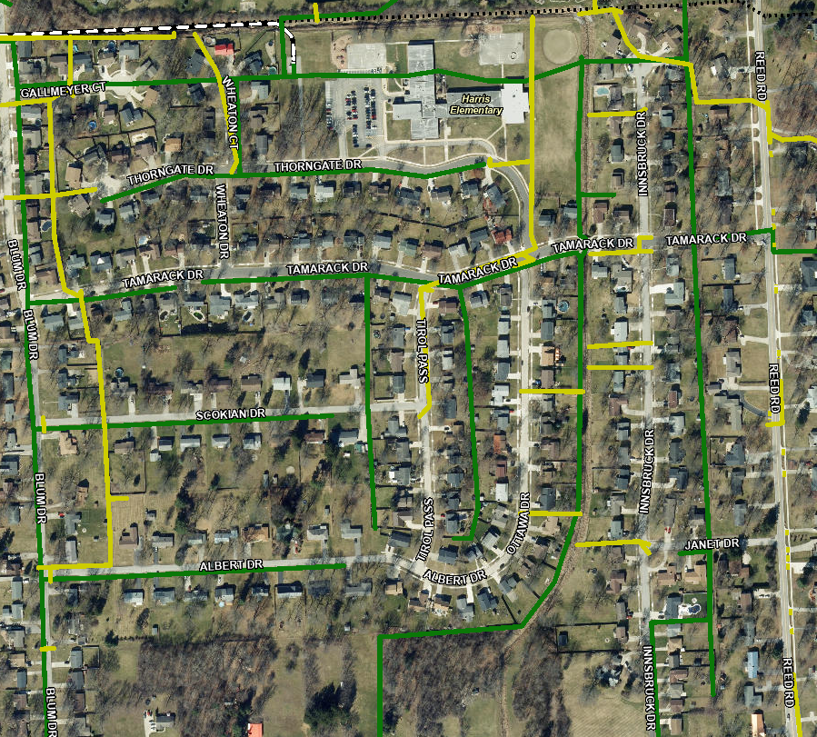
Stormwater System Today
Neighborhood Storm System

Slide 14
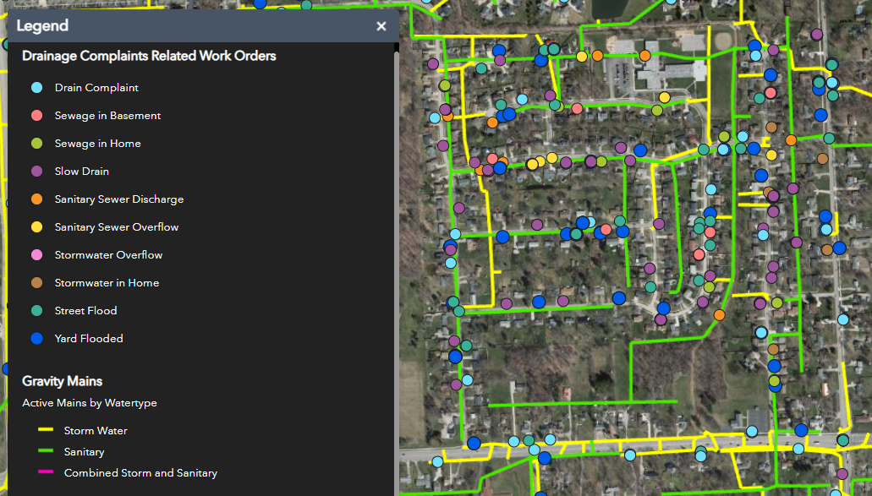
Drainage Complaints
Reminder – Call 311 to report issues

Slide 15
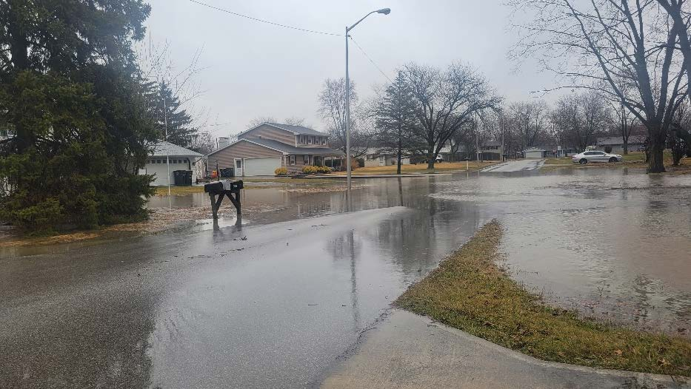
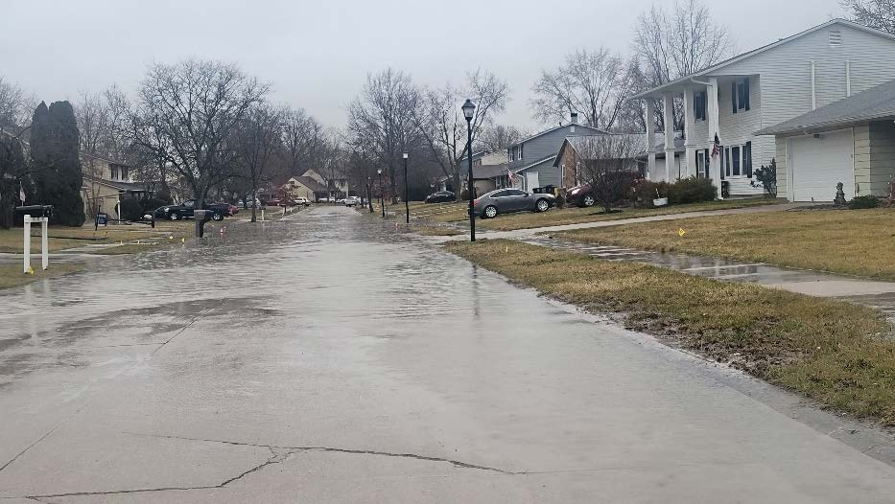
Drainage Issues

Slide 16
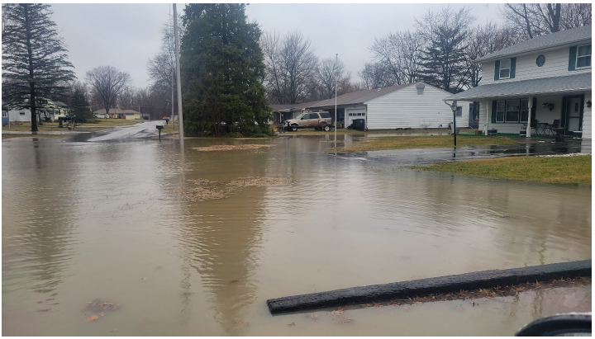
Drainage Issues

Slide 17
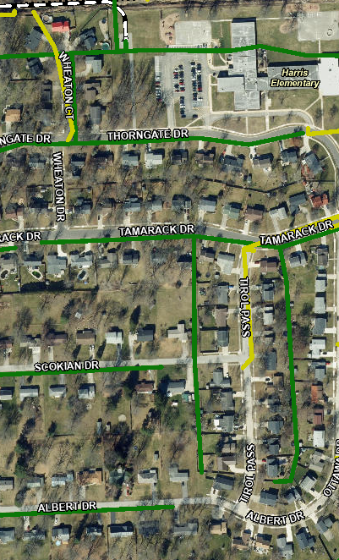


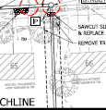
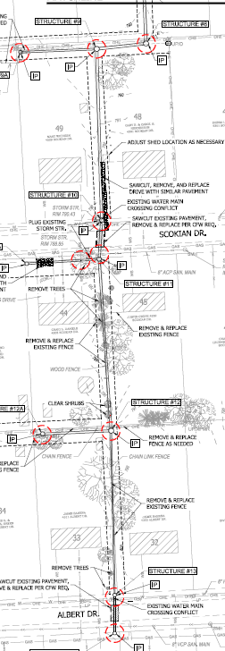
Proposed Solution
New Bioswale outfall into Schoppman Drain
New Stormwater Quality Unit
Storm Main extensions for Phase 2

Slide 18
Proposed Solution
Highlight the Bioswale outfall to Schoppman drain
Highlight Water Quality Unit
Show Storm Extensions for Phase 2 improvements

Slide 19
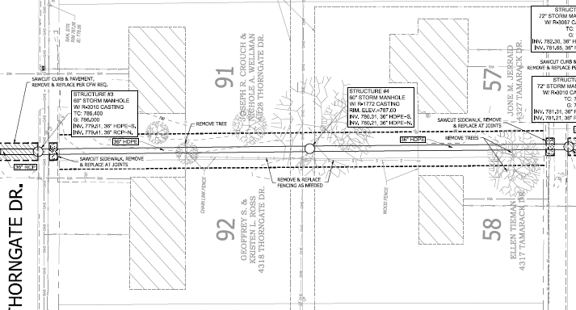
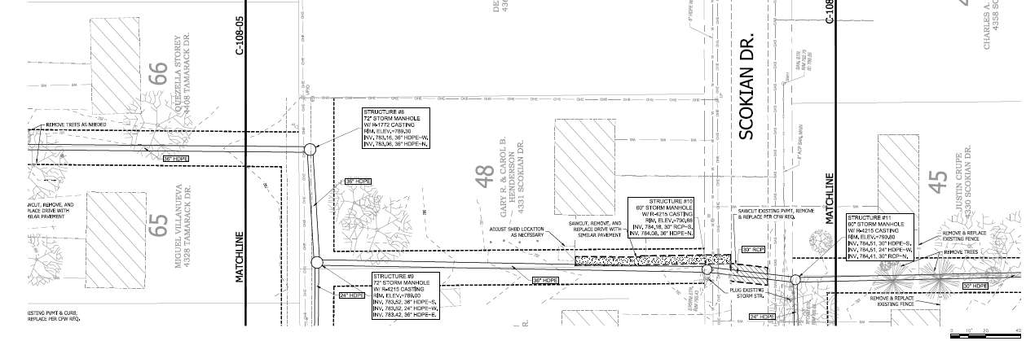
Back/Side Yard Work Limits

Slide 20
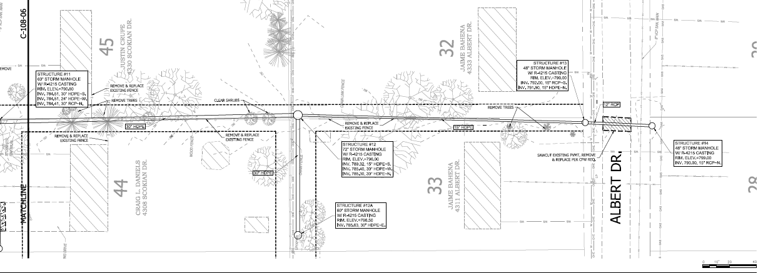
Back/Side Yard Work Limits

Slide 21
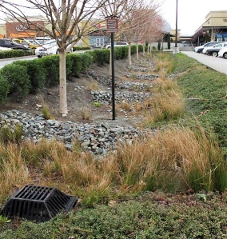
Bioswale Example

Slide 22
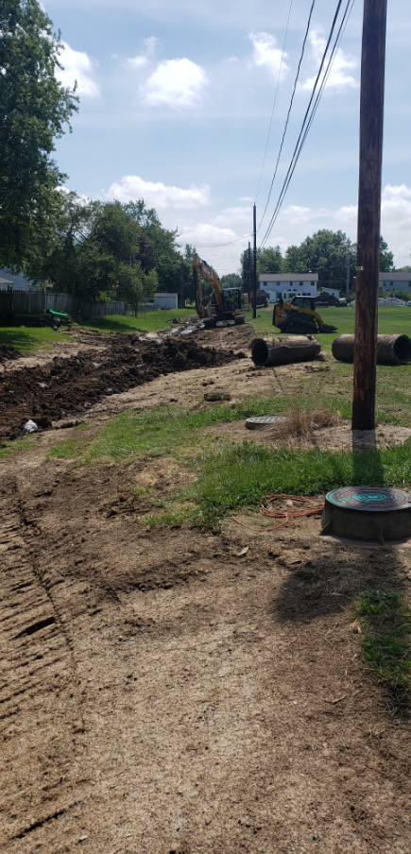
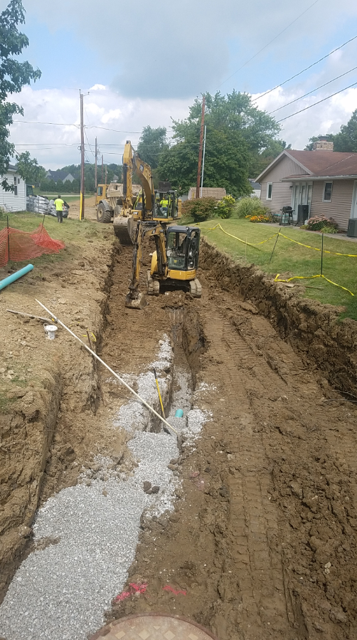
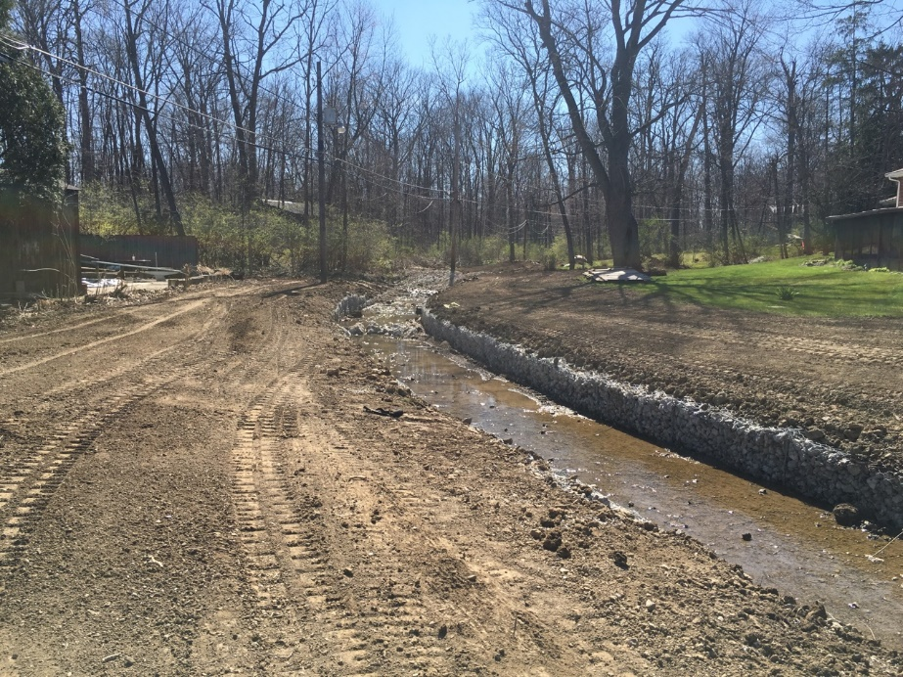
Example Construction Photos

Slide 23
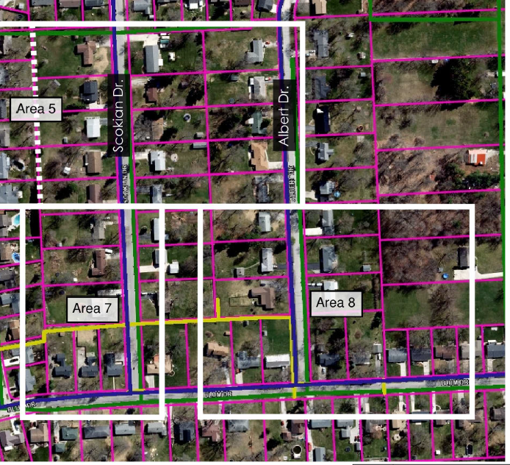
Future Phase 2
Phase 2: Will include stormwater improvements in Area 7 & 8

Slide 24
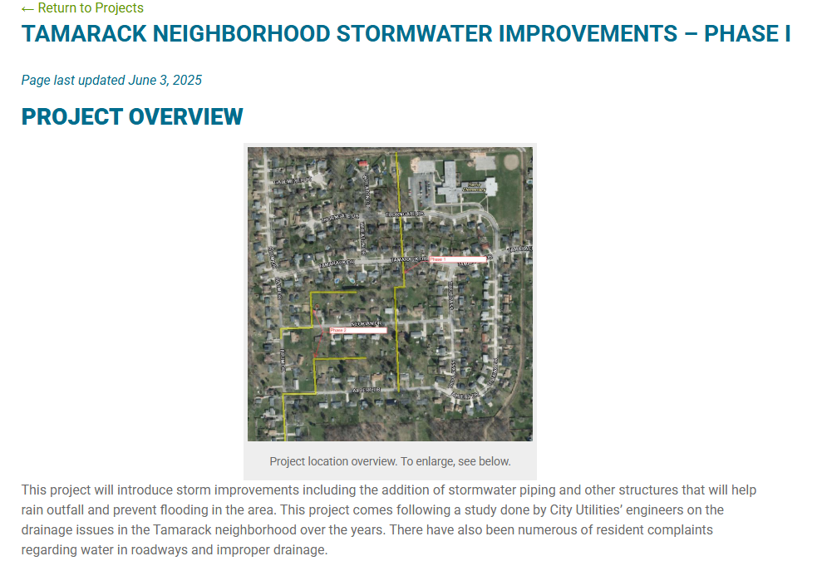
Next Steps – Anticipated Schedule
Complete Final Design, Property Acquisition, Permitting, and Utility Coordination
Anticipate bidding to start late fall/early winter
Construction anticipated to start Beginning of 2026 and continue through Summer 2026
Project info will be on City Utilities Website (including this presentation after the meeting)
utilities.cityoffortwayne.org/tamarack

Slide 25
Questions
Jacob Fowler
Project Manager
City of Fort Wayne – Utilities Engineering
427-2681
Jacob.Fowler@cityoffortwayne.org
Kristen Buell, P.E.
Wet Weather Engineer
City of Fort Wayne – Utilities Engineering
427-2583
Kristen.Buell@cityoffortwayne.org

